Slide 1

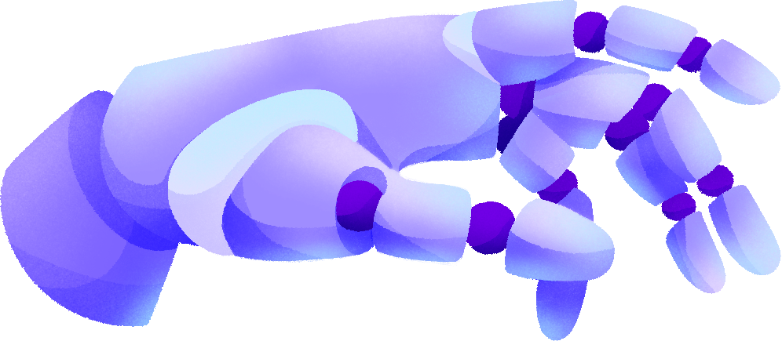

ULTRA
PROSTHETIC LIMBS
REVOLUTIONIZING SMART PROSTHETICS WITH AI & QUANTUM COMPUTING
Tasneem Mosameh & Tuqa Ateeq
29 Jan, 2025

Slide 2

INTRODUCTION & PROBLEM STATMENT
This project aims to transform prosthetics by using AI and quantum computing to create , responsive, and adaptive solutions for individuals with limb loss.
Global Issue:
Millions worldwide struggle with limb loss and outdated prosthetics.
Prosthetics lack responsiveness and adaptability, affecting mobility and daily life.This slows progress on health and equality goals (SDG 3: Good Health and Well-Being & SDG 10: Reduced Inequalities).
Local Issue in Palestine:
Many lose limbs due to conflict and accidents.Traditional options fail to meet needs, especially in tough terrains and limited resources.

Slide 3
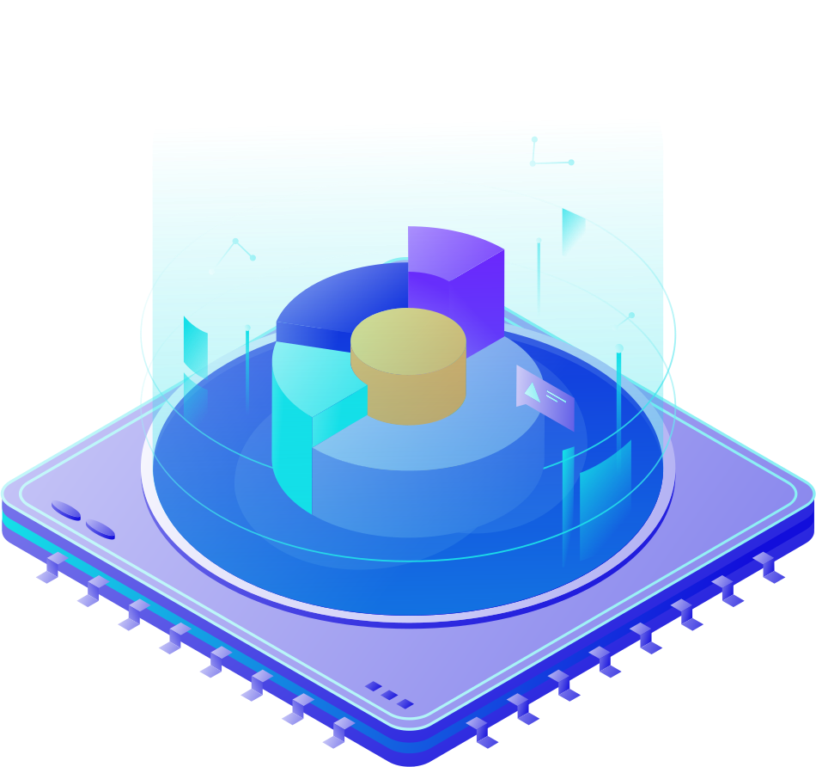
FEASIBILITY & POSITIVE IMPACT
Positive Impact: The project enhances quality of life and promotes social inclusion for individuals with limb loss.
Achieving Goals: It supports the UN Sustainable Development Goals (SDGs), particularly in health and equality.
Feasibility: The project offers sustainable solutions that can be implemented on a wide scale to address the problem effectively.

Slide 4
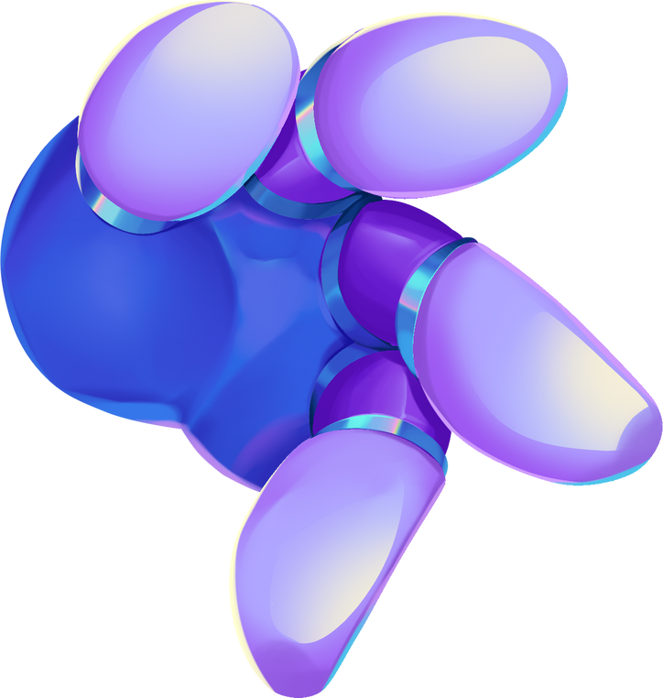
OBJECTIVES
1 | Create advanced prosthetics using AI and quantum computing for improved performance.
2 | Improve user comfort and interaction with the prosthetics.
3 | Offer adaptive and responsive prosthetic solutions that adjust to different environments and user needs.

Slide 5

AI & MACHINE LEARNING INTEGRATION
1- Prosthetic Efficiency Through AI
Enhance prosthetic functionality by leveraging AI to understand and adapt to user needs.
2- Machine Learning Algorithms for Data Analysis & Decision-Making
Use machine learning to analyze user movement patterns and predict behavior based on historical data.
3- Real-Time Adaptation for Improved Comfort & Precision
AI models predict and adapt prosthetic movements in real-time, improving user comfort and prosthetic efficiency based on environmental changes.
4- Python for Data Collection & Processing
Use Python to collect and process data from sensors, ensuring efficient data handling and integration with AI models for real-time analysis.

Slide 6
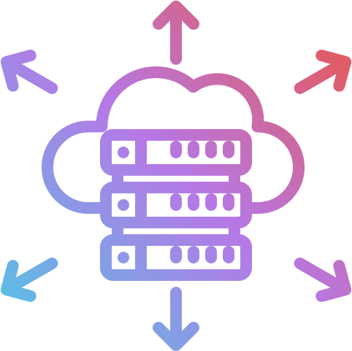
USE OF COMPUTING TECHNIQUES
Cutting-edge Technology Integration
Use quantum computing for fast data analysis and precise movement prediction.
Handles complex calculations at incredible speeds, revolutionizing prosthetic functionality.
Prosthetic can instantly compare new readings with past cases, ensuring quick and proper responses.
Quantum Computing & Grover's Algorithm:
Processes bio-signals quickly, improving accuracy in decision-making.
Grover’s Algorithm greatly speeds up searching through bio-signal data, enabling quick detection of critical patterns (e.g., oxygen level drops, irregular heartbeats).

Slide 7
PSEUDO-CODE
INPUT:
- bio_signals: List of numerical values representing bio-signals.
- threshold: A value to define the condition for significant patterns (e.g., heart rate > 80 bpm).
Output:
- indices: Indices of the bio_signals that meet the condition.
Steps:
1. **Preprocessing**:
a. Normalize the bio_signals (optional, if they have varying scales).
b. Convert bio_signals into binary format suitable for quantum computation.
2. **Initialize Quantum Circuit**:
a. Define `n_qubits` = number of qubits needed to represent the signal indices in binary form.
b. Apply Hadamard gates to all qubits to create an equal superposition of all states.
3. **Define Oracle**:
a. For each binary index:
- Check the corresponding bio_signal value.
- If the value satisfies the condition (e.g., bio_signal > threshold):
- Mark the corresponding quantum state by flipping its phase using a Z-gate.

Slide 8
4. **Apply Diffusion Operator**:
a. Reflect all quantum states around their mean amplitude to amplify the probability of marked states.
5. **Iterate Grover's Algorithm**:
a. Repeat the following steps approximately √N times, where N is the number of states:
- Apply the Oracle to mark target states.
- Apply the Diffusion Operator to amplify the marked states.
6. **Measure the Qubits**:
a. Perform a quantum measurement to collapse the quantum states.
b. Extract the indices of the states with the highest probabilities.
7. **Map Results to Original Data**:
a. Convert the measured indices back to the corresponding bio_signals.
b. Output the significant bio_signals and their indices.

Slide 9

FRONTEND AND BACKEND DESIGN
Innovative Design
User-friendly interface with intuitive controls for easy use by patients.
Real-Time Display
Displays bio-data and prosthetic settings in real-time, enabling instant adjustments.
Device Compatibility
Compatible with smartphones, tablets, and desktops for flexible access.
Tech Stack
Backend: Python (Flask/Django) and Quantum for processing.
Frontend: HTML, CSS, and JavaScript for an interactive experience.

Slide 10
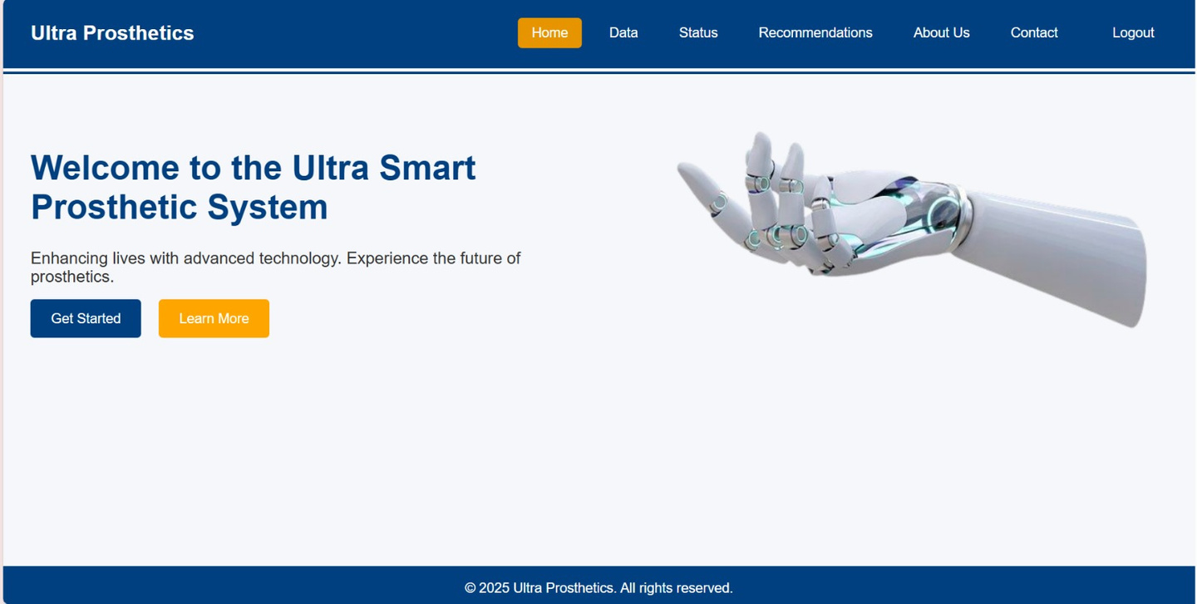
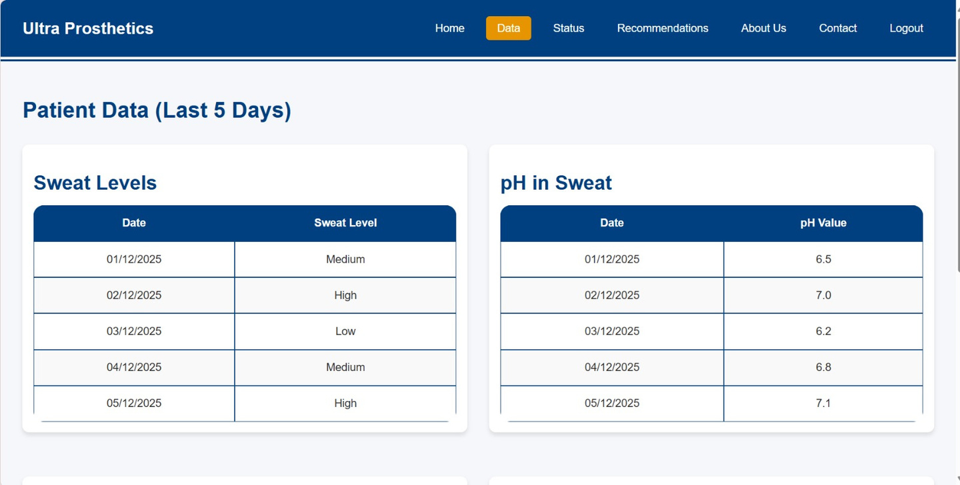

Slide 11
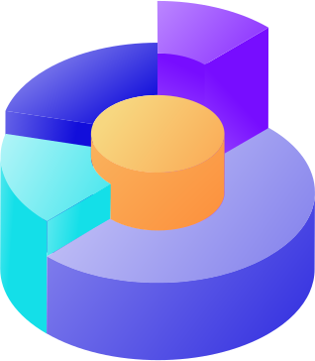
DATA CREATIVITY & INNOVATION
The first project of its kind integrating quantum computing with prosthetics.
Utilizes quantum computing for fast and accurate bio-signal analysis.
Enables precise movement prediction and enhances prosthetic performance.
Offers innovative rehabilitation solutions using cutting-edge technology.
Features an innovative design powered by AI to analyze bio-signals.

Slide 12
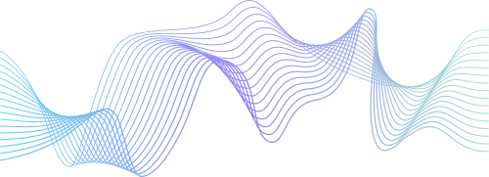
FUTURE VISION
- Integration of Prosthetics with Cloud Services:
Developing smart prosthetic limbs with IoT sensors to collect data in real-time and securely store it on a cloud infrastructure, ensuring seamless integration through API interfaces.
- Enhancing Real-Time Analysis:
Improving AI algorithms for faster signal analysis and utilizing quantum computing for quicker processing of real-time data.
- Collaboration with Medical Professionals:
Collaborating to test the system in real-world environments and gathering feedback from users and experts to improve performance.
- Data Processing and Metrics:
Currently, we focus on analyzing real-time data such as pH in sweat, heart rate, and oxygen saturation. In the future, we will add blood pressure, body temperature, and glucose levels, while making the prosthetics eco-friendly, comfortable, and pain-free.

Slide 13
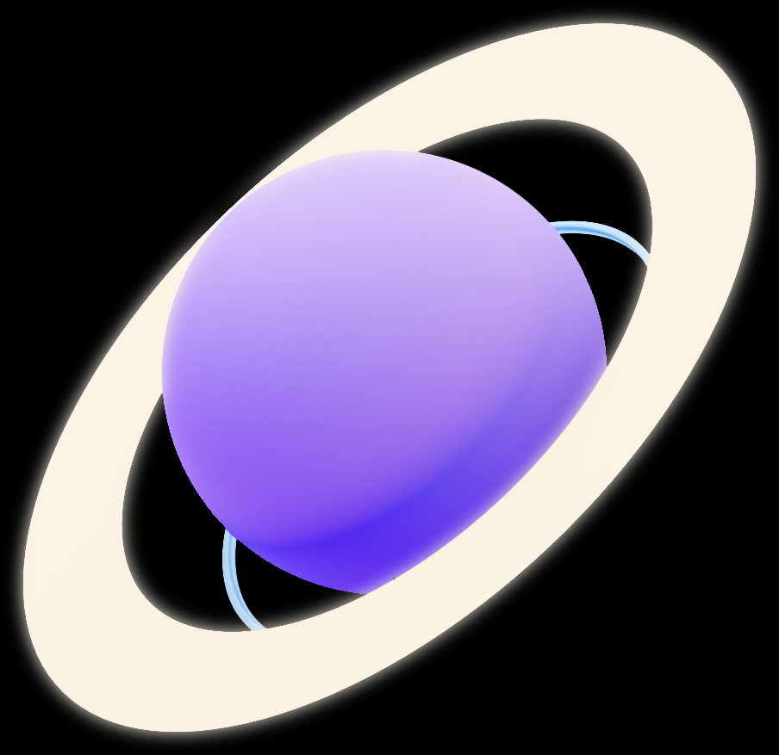
THANK YOU FOR YOUR ATTENTION!
We look forward to transforming lives with innovative, comfortable, and eco-friendly solutions

